Slide 1

Quasiparticle and electron-hole excitations in solids: theory and computation
(Part 2)
Peihong Zhang
Department of Physic, University at Buffalo

Slide 2
Outline
Quasiparticle concept, quasiparticle band structure and band gap
Quasiparticle equation, self-energy, and the GW approximation
First-principles GW method
Success and challenges of the GW method
Acceleration techniques: Energy-integration
GW calculations of 2D materials
Electron-hole excitations and the Bethe-Salpeter equation

Slide 3
GW calculations for large systems?
High-throughput GW calculations?
(Forget about ZnO or CuCl) For a 2-atom MgO, we need about 1,000 conduction bands to converge the result
Suppose we are interest in a system containing 200 atoms
(e.g, a supercell containing a defect), we will need
to achieve the same level of convergence
Not only calculating the wave functions is hard (if possible), but storing these wave functions is extremely problematic, not to mention the subsequent GW calculations

Slide 4
Speed up GW calculations for large systems?
Explicit band-by-band summation
Integration/sampling
Do we really need an explicit band-by-band summation?
DOS of MgO
Scientific Reports 6, 36849 (2016).

Slide 5
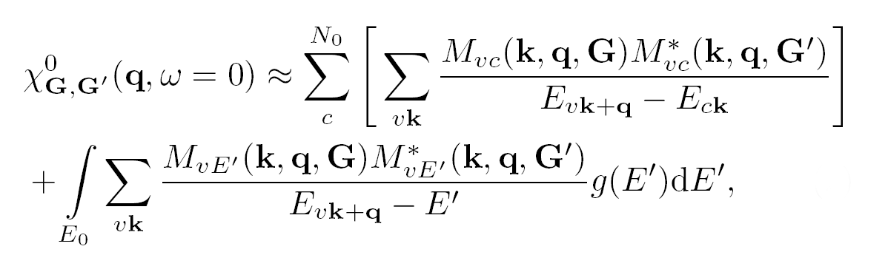
Speed up GW calculation for large systems
Contributions from high energy states are calculated by an energy integration:
: free-electron-like DOS
Low-energy states
High-energy states
Scientific Reports 6, 36849 (2016).

Slide 6
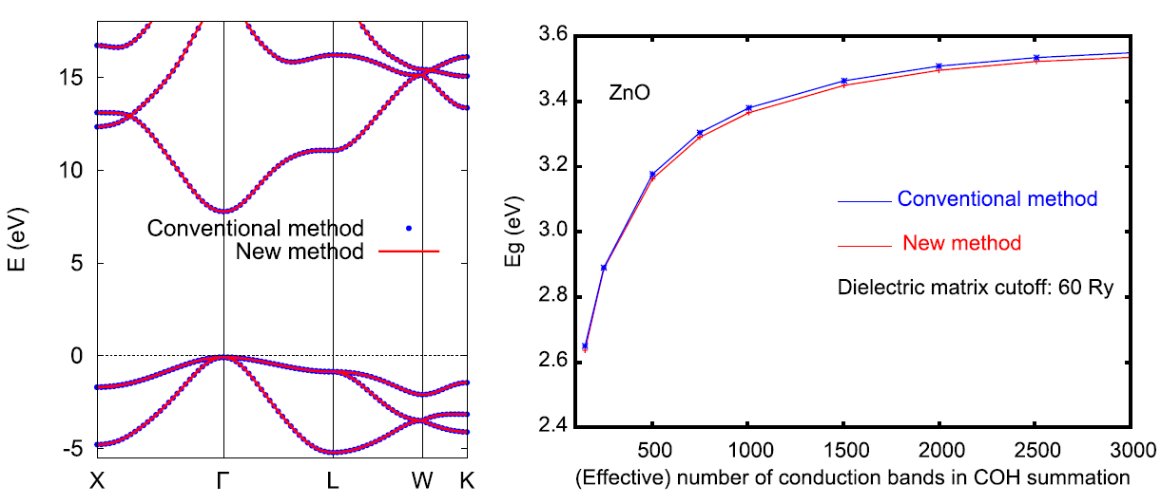
Accuracy/performance of the new method
100 180 250 310 360 400
QP band structure of MgO
QP band gap of ZnO
Scientific Reports 6, 36849 (2016).

Slide 7
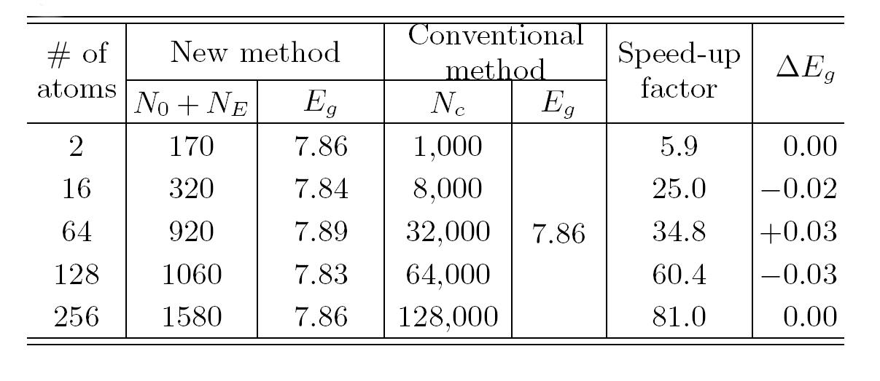
Large scale GW calculations
Band gap of MgO supercells
A speed-up factor of nearly two orders of magnitude is achieved
Numerical error: less than ±0.05 eV
Scientific Reports 6, 36849 (2016).

Slide 8
Outline
Quasiparticle concept, quasiparticle band structure and band gap
Quasiparticle equation, self-energy, and the GW approximation
First-principles GW method
Success and challenges of the GW method
Acceleration techniques
GW calculations of 2D materials
Electron-hole excitations and the Bethe-Salpeter equation

Slide 9
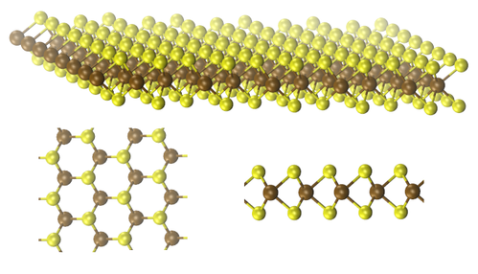
What about 2D materials?
Reported GW band gap of MoS₂:
2.41 ~ 2.84 eV
(without including spin-orbit interactions)
Methods: G⁰W⁰, G¹W⁰, self-consistent GW, etc
Parameters used:
- Number of conduction bands (3-atom unit cell): 96 to 10,000
- k-point sampling: 6x6x1 to 24x24x1
- Who do you trust?
MoS₂
PRB 85, 205302 (2012); PRB 86, 115409 (2012);
PRB 87, 155304 (2013); PRB 88, 045412 (2013);
PRL 115, 119901 (2013)

Slide 10
GW calculations for 2D materials: Challenges
Need to avoid fictitious interlayer interaction
- Long-range Coulomb interaction means slow convergence with respect to the interlayer distance; a large vacuum layer is needed even if truncated Coulomb interaction is used
- A large number of conduction bands (Nc) is needed
Asymptotic behavior of the
dielectric function at small q
An extremely dense k-grid is
needed for 2D GW calculations
3D
Sudden change at small q
Smooth as q->0

Slide 11
2D materials
GW band gap of MoS2 as a function of number of bands included in the calculation
New method
(Energy integration)
MoS2
Old method
(band-by-band summation)

Slide 12
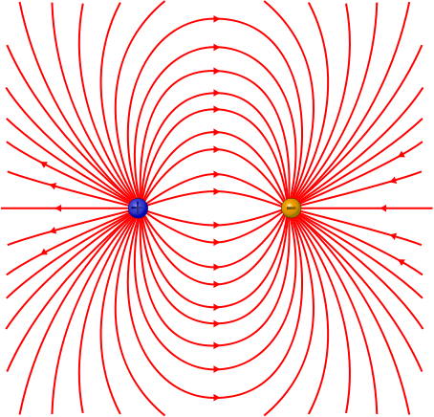
2D dielectric screening
Ineffective long wave length screening

Slide 13
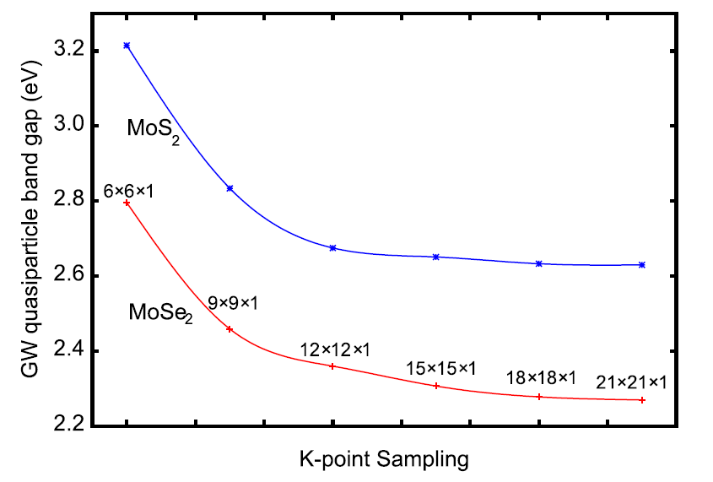
2D materials
Fully converged GW calculations for 2D materials with a speed-up factor of about 20 ~ 30
The GW band gap converges extremely slowly! Why?

Slide 14
GW calculations for 2D materials: Challenges
For simple 2D materials such as MoS₂ and MoSe₂, we need ~10,000 bands and at least a 24x24x1 k-grid to properly converge the quasiparticle properties using conventional GW methods
Scaling of the computational cost of GW calculations with respect to number of k points:
- Compared with a calculation using a 6x6x1 k-grid, a calculation using a 24x24x1 k-grid is
Also, the number of bands will scale linearly with the system size, and the computation cost scales as
It is nearly impossible to carry out fully converged GW calculations for complex 2D materials using current methods

Slide 15
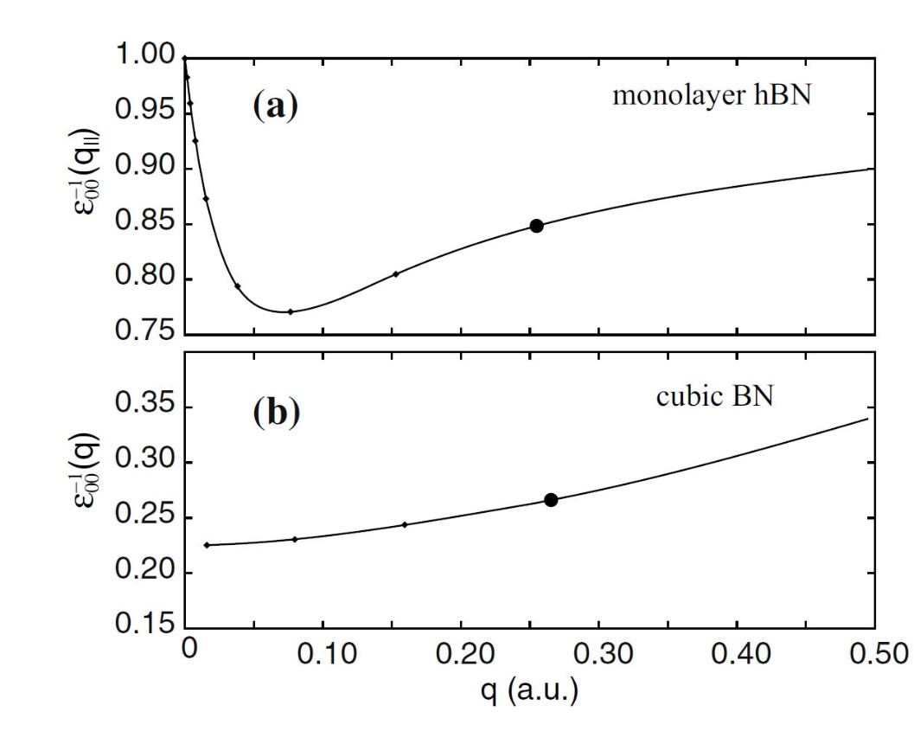
GW calculations for 2D materials: Challenges
In the conventional GW approach, the integration of the self-energy within the Brillouin zone (BZ) is carried out by a summation on a uniform k-grid:
This approach is highly inefficient for 2D materials because of the sharp change in the dielectric
function near q = 0.

Slide 16
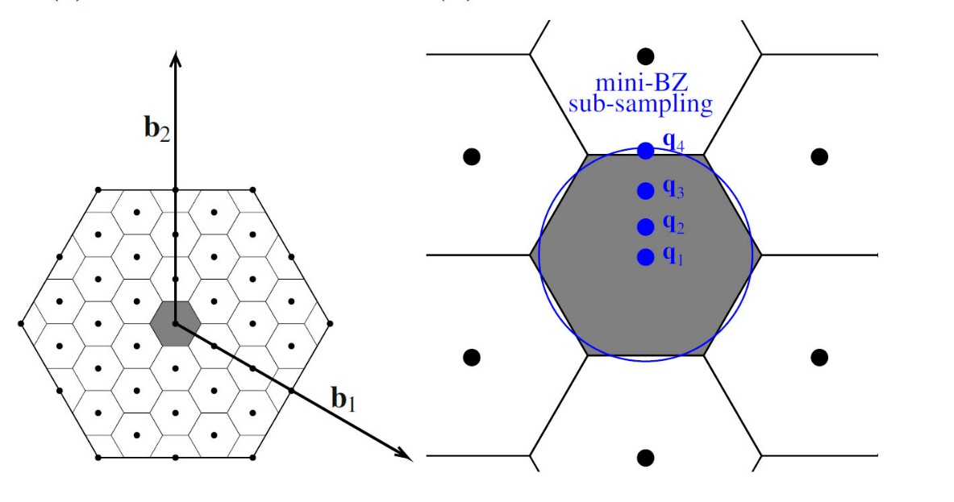
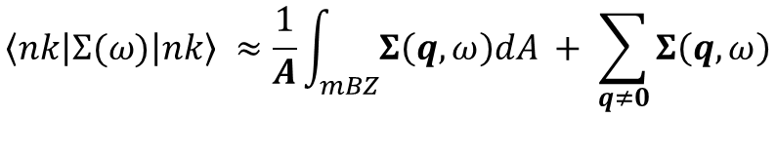
Mini-BZ sub-sampling fitting and analytical integration
Our approach: Sub-sampling the mini-BZ C_{q} near q = 0
The BZ summation of the electron self-energy is separated into two parts: conventional summation of all k points other the Γ point, and an analytical integration in the mini-BZ
$$\left\langle \left.nk\left|Σ(ω)\right|nk\right\rangle \right. ≈\frac{1}{A}\int_{mBZ}{Σ\left(q,ω\right)dA} + \sum_{q≠0}{Σ\left(q,ω\right)}$$
2D Materials 6, 015018 (2019). Nanoscale, 11, 3993 (2019).
NPJ Comput. Mater. 6, 118 (2020).

Slide 17
Performance of the new Method
hBN
(2-atom)
C₂N
18-atom
(NxNx1)
(NxNx1)
Note that the results calculated using the conventional k-point sampling approach do not seem to converge even at extremely high k-density
MoS₂
3-atom
(NxNx1)

Slide 18
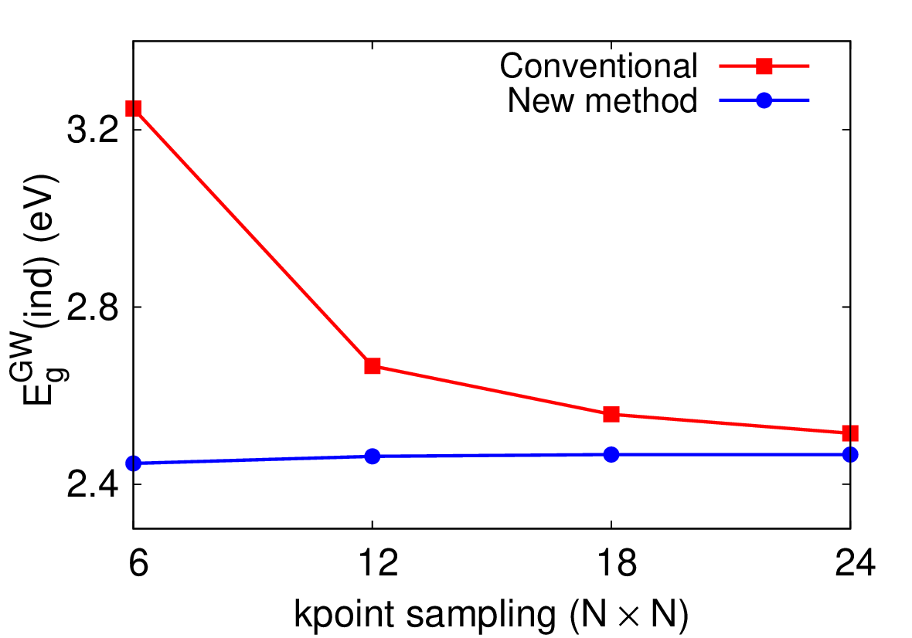
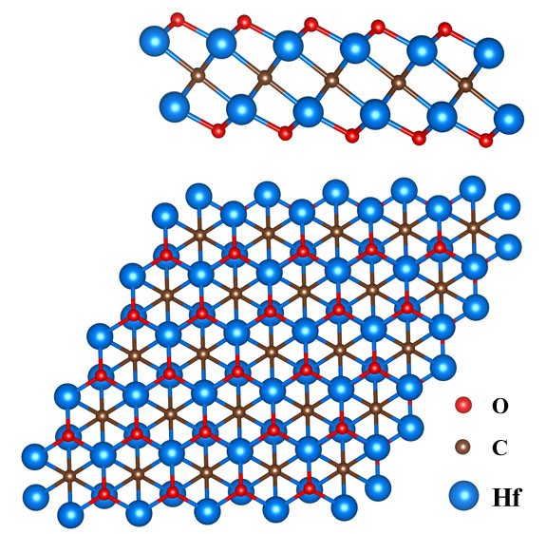
Performance of the new method
Nanoscale, 11, 3993 (2019).
GW band gap of single-layer Hf₂CO₂ MXene as a function of k-point sampling density.
Our new methods result in a combined speed-up factor of ~ 1,000 times for GW calculations of complex 2D materials.

Slide 19
Outline
Quasiparticle concept, quasiparticle band structure and band gap
Quasiparticle equation, self-energy, and GW approximation
First-principle GW method
Success and challenges of the GW method
Acceleration techniques
GW calculations of 2D materials
Electron-hole excitations and the Bethe-Salpeter equation

Slide 20
Optical absorption
Optical absorption spectrum of solids is typically described by the imaginary part of the (frequency-dependent) macroscopic dielectric function, i.e., .
Various other optical properties can be calculated using both the real and the imaginary parts of the dielectric function. For example, the absorption coefficient α:
On a single particle level, one have
where is the polarization vector of light, and is the velocity
operator, and are the valence and conduction states

Slide 21
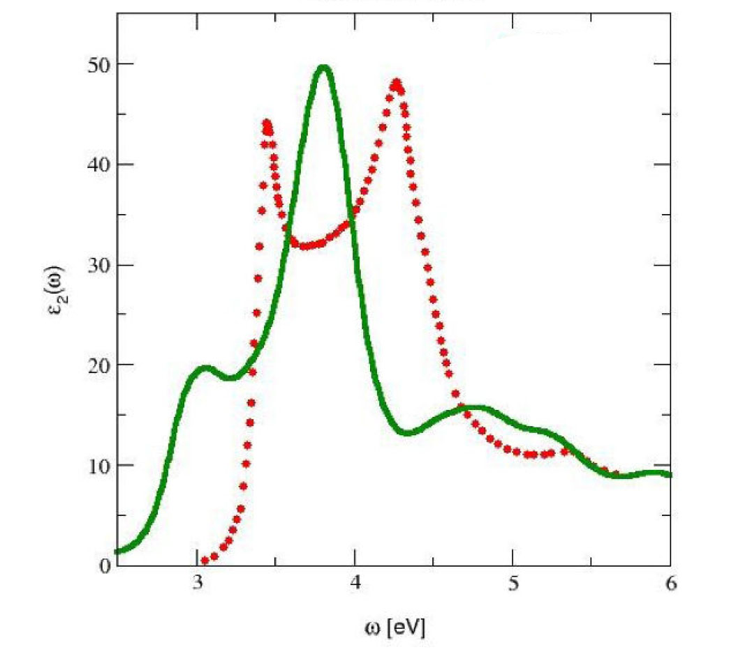
Optical absorption: single particle calculation
How well does theory work?
silicon
Exp
Pretty bad!
Thr.

Slide 22
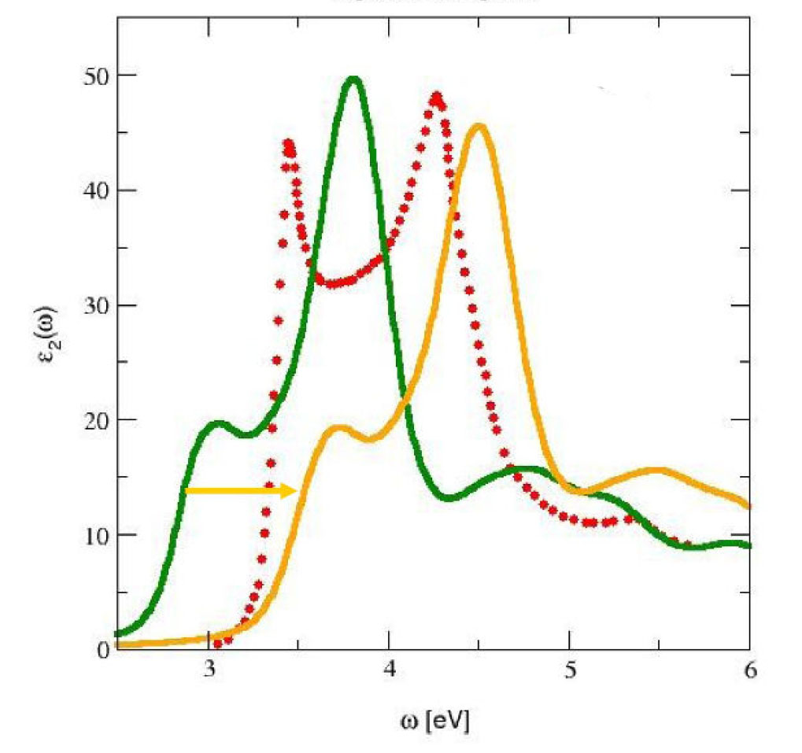
Optical absorption: single particle calculation
DFT
Exp
What goes wrong?
If calculated using DFT results, the KS band gap could be way off. This can be resolved by including the GW self-energy correction.
Still NOT right!
silicon
GW

Slide 23
Optical absorption: single particle calculation
What is still missing?
The excited electron and the hole it leaves behind have interaction!
DFT
Exp
GW
silicon

Slide 24
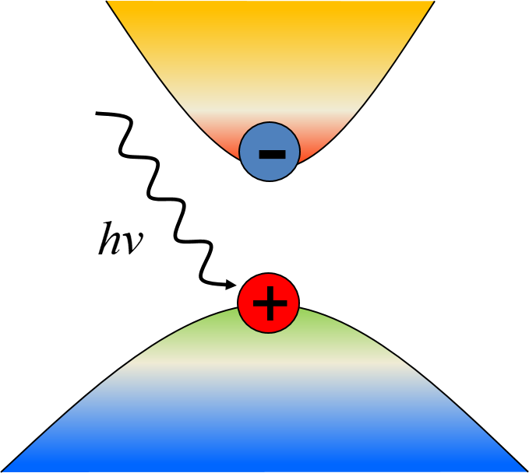
Electron-hole excitations
The GW theory can describe ONE-particle excitations well
However, optical excitations actually involve TWO particles: an electron and a hole
Interaction between the electron and hole must be included in the calculation

Slide 25
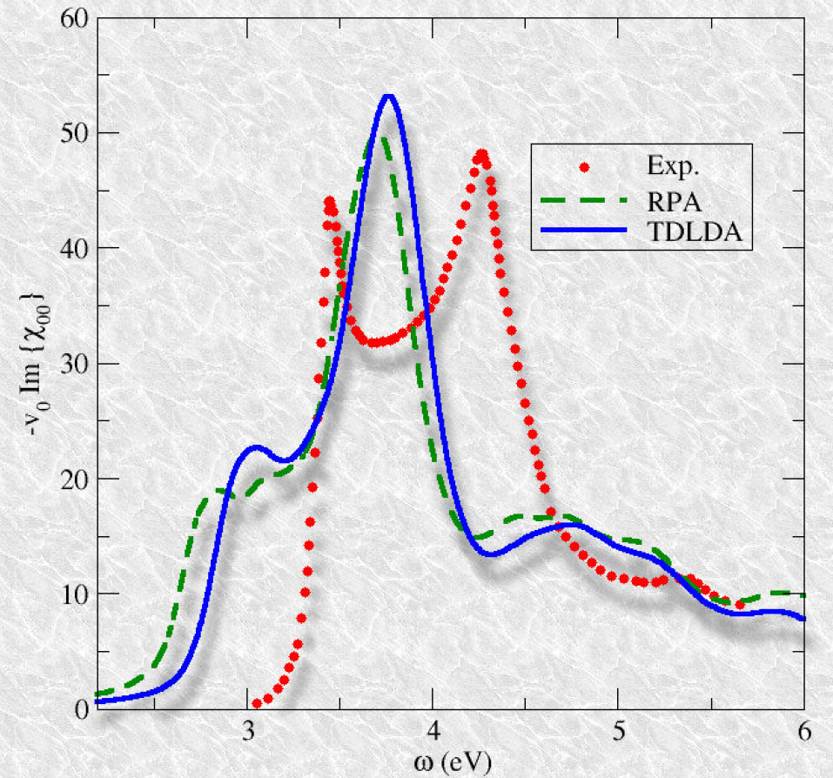
What about TDDFT?
TDDFT seems to work better for localized/isolated systems with highly non-uniform charge densities, e.g., atoms and molecules
Unless specialized functionals and kernels are used, TDDFT does not give accurate optical absorption spectra for solids

Slide 26
Electron-hole excitations and the pair correlation function
The propagation of an electron-hole pair is described by the two-particle correlation function L
Non-interacting pair correlation function:
(indices 1,2,3,4 stand for space, time, and spin variables)
With interaction,
1
1’
2’
2
electron
hole
electron
hole

Slide 27
Explicit expression for the pair correlation function
The pair correlation function can be written explicitly if we know the (interacting or non-interacting) pair states:
where are the non-interacting conduction and valence
states and are the interacting pair states with excitation
energy .

Slide 28
Bethe-Salpeter equation for the pair correlation function
Formally, the interacting pair correlation function and the non-interacting one is related by the Dyson equation
electron
hole
In this case, it is also known as the Bethe-Salpeter equation (BSE)
where K is called the electron-hole kernel

Slide 29
Solving the Bethe-Salpeter equation
The main idea of using many-body perturbation theory to solve the BSE is that one can start with mean-field KS solutions to obtain quasiparticle properties within the GW approximation. The electron-hole interaction is then
In the BSE, the excitations and de-excitations are coupled, making the calculations rather difficult.
Often one use the so-called Tamm-Dancoff approximation (TDA) to decouple the excitation and de-excitations, leading to a much simplified BSE

Slide 30
The TDA and the Bethe-Salpeter equation
Using the TDA, the BSE can be casted into a simplified eigenvalue problem:
where is the e-h excitation energy and the eigen vector
can be used to constructor the e-h pair (excitonic) states:
At this point, we need to examine more carefully the spin aspect of the e-h pair. For a given e-h pair, we have the following spin states:
which give rise to spin singlet and triplet solutions.

Slide 31
The TDA and the Bethe-Salpeter equation
The electron-hole Hamiltonian matrix looks like this
Within the singlet subspace, , the Hamiltonian is simplified
Within the triplet space,

Slide 32
The TDA and the Bethe-Salpeter equation
The imaginary part of the dielectric function is then
Or

Slide 33
Modern approach to electronic excitations in solids
DFT (mean-field)
-
GW (self-energy)
+
BSE (e-h coupling)
Electron-hole excitations
Notes:
33

Slide 34
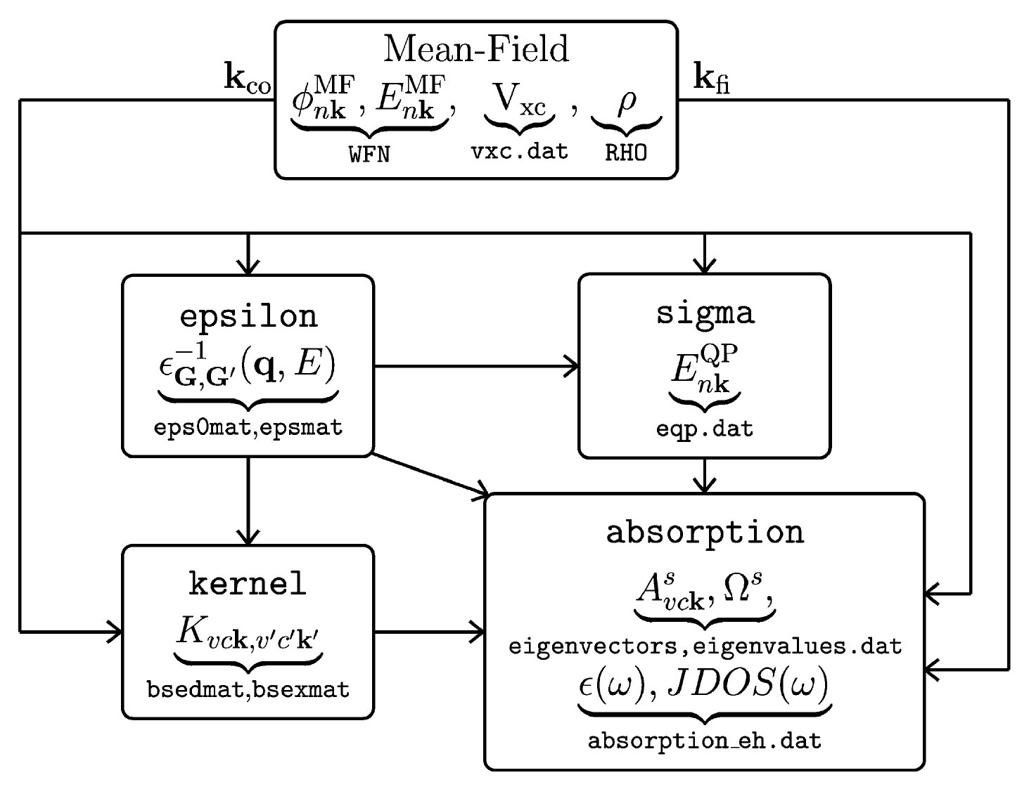
The BerkeleyGW package (https://berkeleygw.org/)
Computer Physics Communications 183, 1269 (2012)
Notes:
34

Slide 35
Optical absorption of semiconductors
from first-principles: Silicon
Theory
◊◊◊◊◊◊◊
Exp.
Theory is now able to compare accurately with experiment without any fitting parameters!
Photon energy (eV)

Slide 36
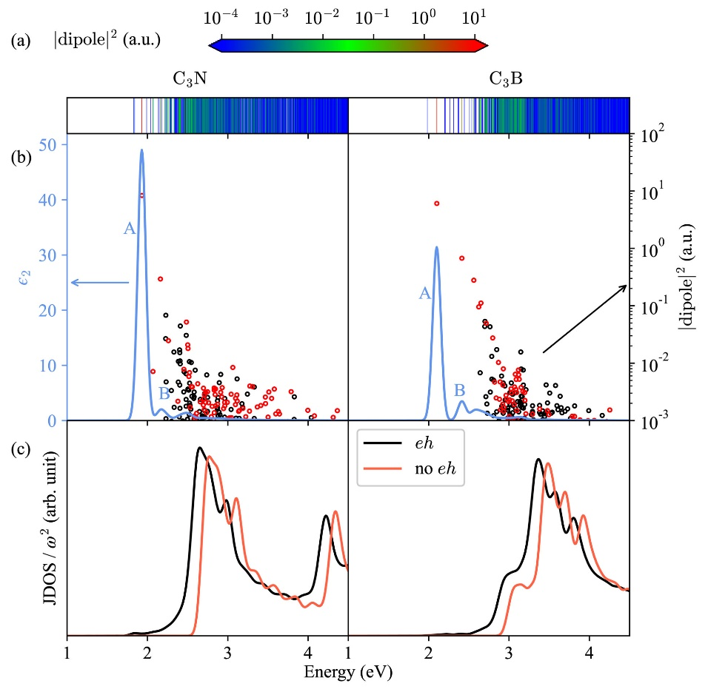
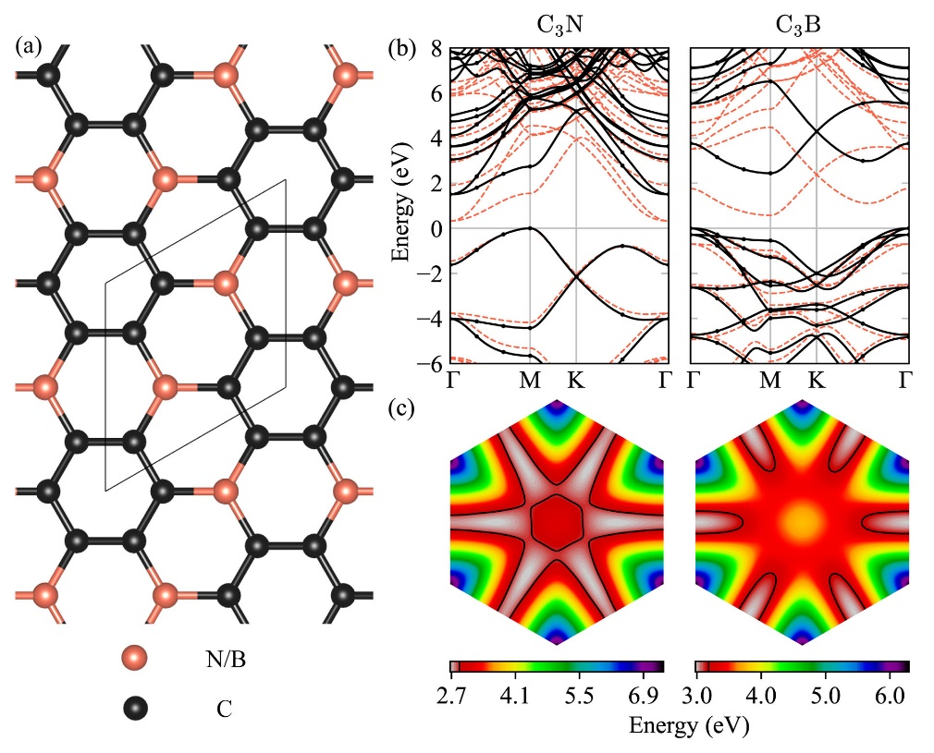
Our recent work

Slide 37
Our recent work

